Slide 1


Healthcare Cost and Resource Utilization
Prepared by:- Abhinav kakkeri

Slide 2
Introduction
This report presents an analytical overview of healthcare costs and resource utilization based on the provided dashboard. The data has been segmented by various factors such as gender, diagnosis code, insurance type, and time parameters (year, month, day) to identify trends and provide actionable insights.

Slide 3
Acknowledgement
This healthcare cost and resource utilization dashboard provides insightful data on patient IDs, diagnosis codes, yearly costs, and total expenditures. The various tables and charts help analyze healthcare trends, resource allocation, and financial impacts

Slide 4
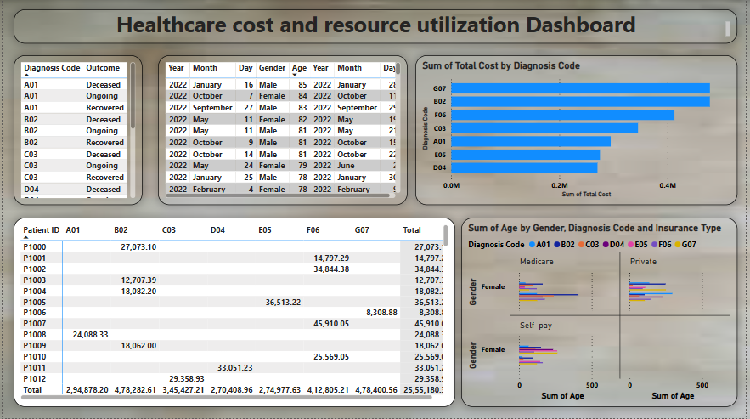
Dashboard

Slide 5
Key points
A. Total Cost Distribution:- The total healthcare expenditure varies significantly based on *diagnosis codes* and *insurance types*.- Certain *diagnosis codes* contribute disproportionately to the total costs.- A notable difference exists in healthcare costs based on *gender*, suggesting varied utilization of medical resources.
B. Insurance-Based Cost Variation:- Patients with different insurance types experience varied healthcare costs.- Certain insurance categories show higher expenditure per diagnosis, which may indicate coverage gaps or high-cost treatments.

Slide 6
Key points
C. Gender Based Analysis :-
The dashboard highlights disparities in healthcare costs between male and female patients.
Specific diagnosis codes show a higher financial burden for one gender over the other.

Slide 7
Conclusion
The insights derived from this data analytics dashboard help stakeholders make informed decisions regarding healthcare expenditure and resource distribution. By implementing strategic interventions, healthcare providers and policymakers can improve cost efficiency while ensuring optimal patient care

Slide 8

THANK YOU

